Slide 1


Emma Sung
5/31/2024

Slide 2

Outline
Executive Summary
Introduction
Methodology
Results
Conclusion
Appendix

Slide 3
Executive Summary
Summary of methodologies:
Data collection
Data wrangling
Perform exploratory data analysis (EDA) using visualization and SQL
Perform interactive visual analytics using Folium and Plotly Dash
Perform predictive analysis using classification models

Slide 4
Introduction
Objective:
Create a new rocket company based off of information from Space X rocket launches.
Predict whether Falcon 9 will land successfully, which will save money for the company
Methodology:
Gather information about Space X and creating dashboards
Determine if SpaceX will reuse the first stage by training a machine learning model and use public information to predict if SpaceX will reuse the first stage.

Slide 5

Section 1

Slide 6
Methodology
Executive Summary
Data collection methodology
Perform data wrangling
Perform exploratory data analysis (EDA) using visualization and SQL
Perform interactive visual analytics using Folium and Plotly Dash
Perform predictive analysis using classification models

Slide 7
Data Collection – SpaceX API
Obtain API key
Data set was collected by requesting rocket launch data from SpaceX API
Decoded the response content using Json and Json.normalize()
Parsed and converted to dataframe
Filtered the dataframe to only include Falcon 9
https://github.com/emmasung1/Applied-Data-Science-Capstone/blob/main/Capstone/Week1/jupyter-labs-spacex-data-collection-api.ipynb
Request data
Authenticate requests
Retrieve Data
Pare JSON Responses
Store data

Slide 8
Data Collection - Scraping
Perform web scraping to collect Falcon 9 historical launch records from a Wikipedia page
Use the request to create BeautifulSoup object that allows us to parse through the HTML document of the Wiki page
https://github.com/emmasung1/Applied-Data-Science-Capstone/blob/main/Capstone/Week1/jupyter-labs-webscraping.ipynb
Request Launch Wiki Page
Create BeautifulSoup Object
Extract all columns and variables with HTML table headers
Create dataframe from parsing HTML tables
Store data

Slide 9
Data Wrangling
Perform some Exploratory Data Analysis (EDA) to find some patterns in the data and determine what would be the label for training supervised models.
Load dataset and parse through the data to create a list of possible outcomes
Use the list of outcomes to label each data as success (value = 1) or fail (value = 0)
Calculate the success rate by the average of outcome value
https://github.com/emmasung1/Applied-Data-Science-Capstone/blob/main/Capstone/Week1/labs-jupyter-spacex-Data%20wrangling.ipynb
Load dataset
Calculate launches at each site
Calculate the number and occurrence of mission outcome of the orbits
Create a landing outcome label from Outcome column
Determine the success rate

Slide 10
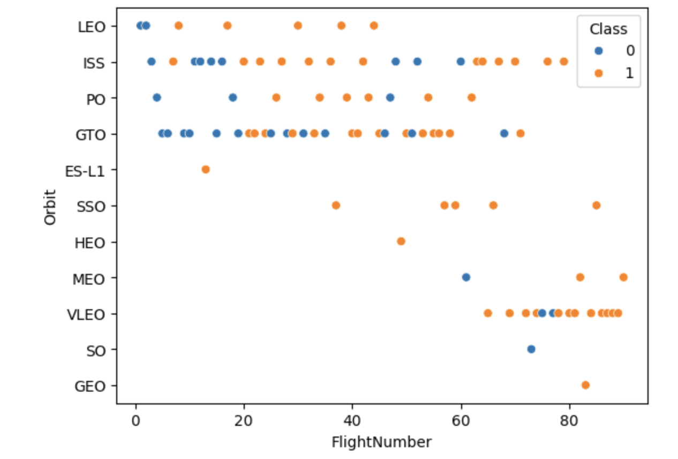
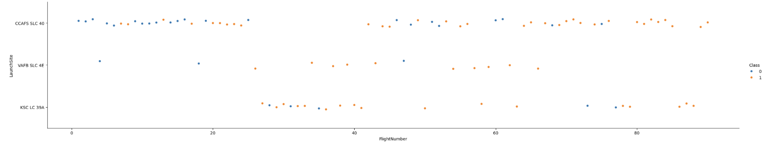
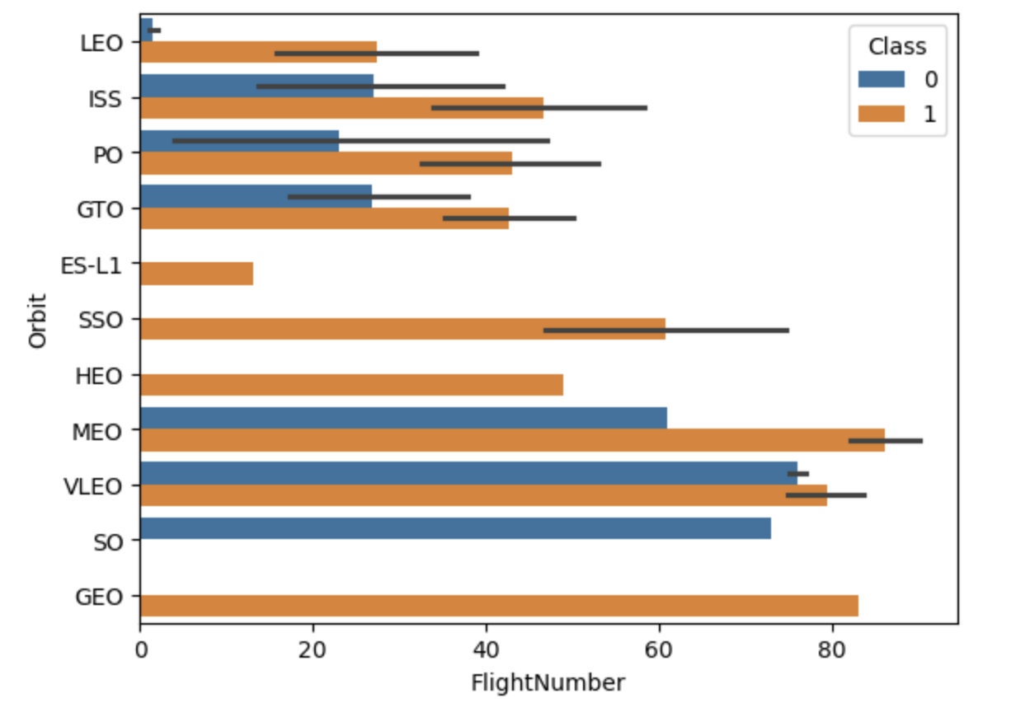
EDA with Data Visualization
Scatterplot of flight number vs. launch site
Visualized that there are consistent successful launches from flight number ~80+
Bar plot of flight number vs. orbit
Visualize the average flight number for success/failure for each orbit.
Scatterplot of Flight Number and Orbit type
LEO orbit the Success appears related to the number of flights; on the other hand, there seems to be no relationship between flight number when in GTO orbit.

Slide 11
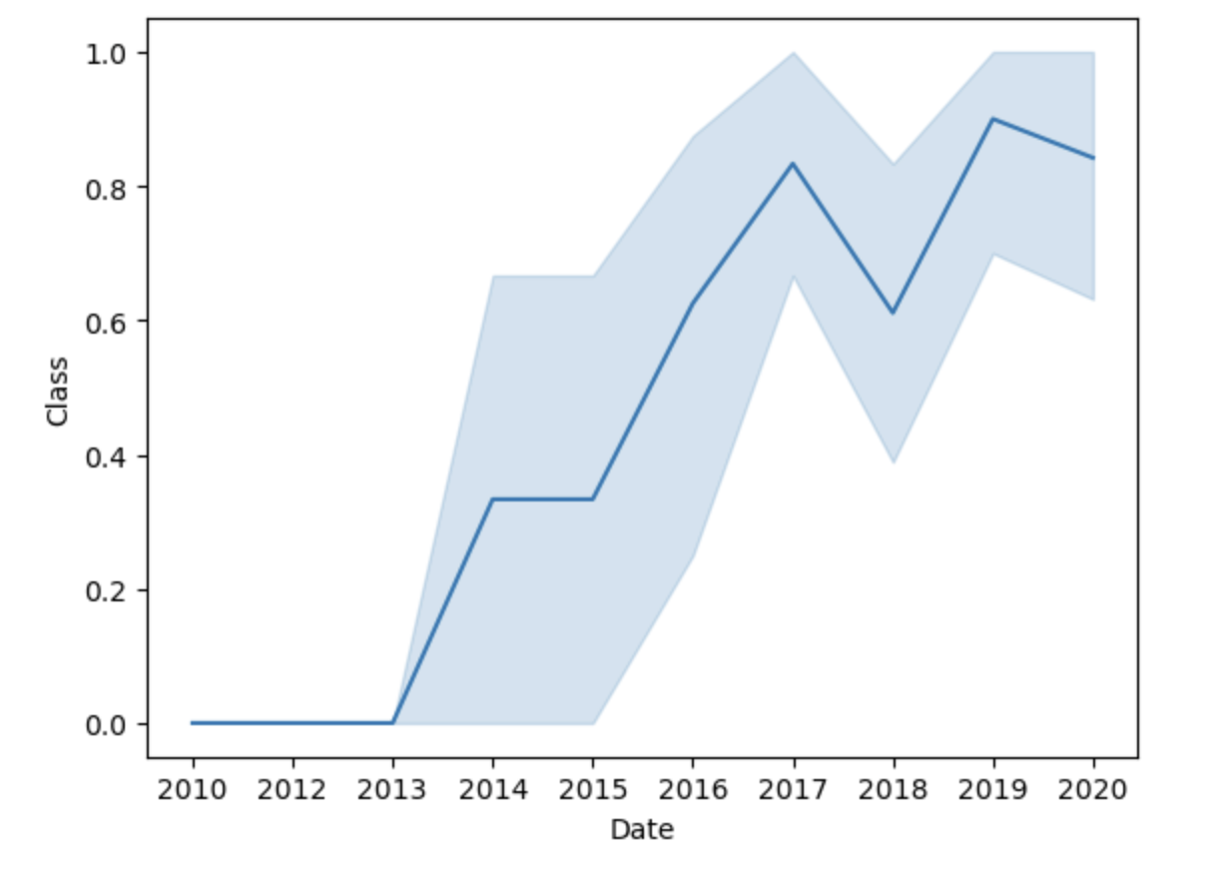
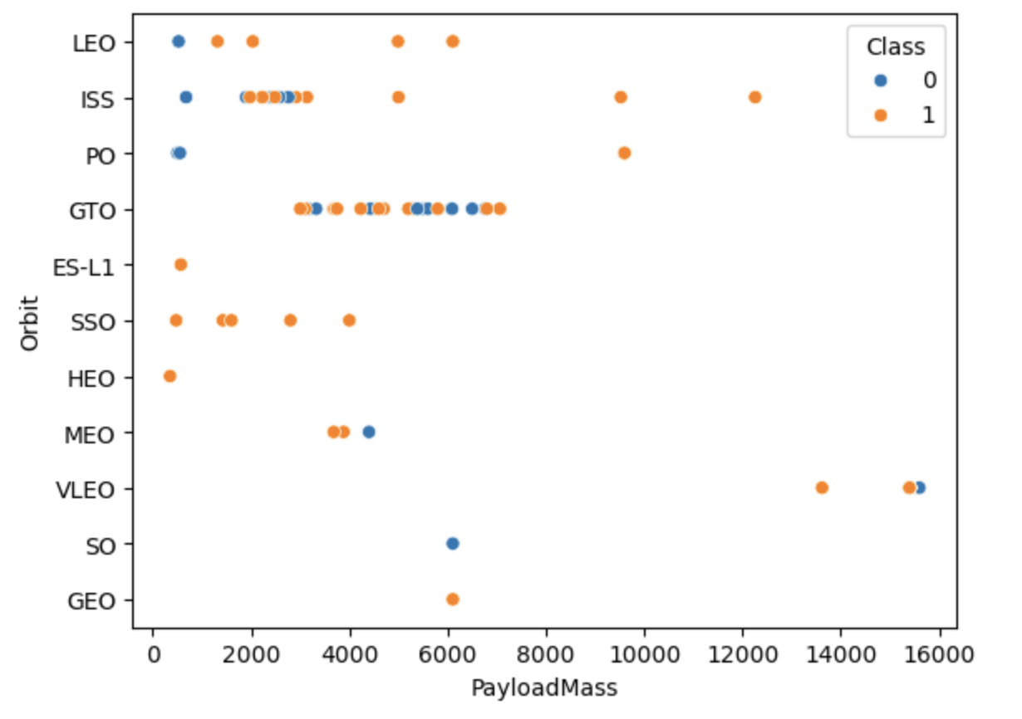
EDA with Data Visualization
Scatterplot of Payload and Orbit type
With heavy payloads the successful landing or positive landing rate are more for Polar,LEO and ISS.
However for GTO we cannot distinguish this well as both positive landing rate and negative landing(unsuccessful mission) are both there here.
Line plot of yearly success rate
observe that the success rate since 2013 kept increasing till 2020
https://github.com/emmasung1/Applied-Data-Science-Capstone/blob/main/Capstone/Week2/edadataviz.ipynb

Slide 12
EDA with SQL
SQL queries performed:
Select
Distinct
Like
Average (AVG)
Sum
Min
Between
Count
Subquery
https://github.com/emmasung1/Applied-Data-Science-Capstone/blob/main/Capstone/Week2/jupyter-labs-eda-sql-coursera_sqllite.ipynb

Slide 13
Build an Interactive Map with Folium
Added markers and circles for each launch site to display visually where the launch sites are located
Lines and distance markers to display distances between a launch site to its proximities (highway, beach, city)
While launch sites are close in proximity to highways and beaches, they are further away from cities.
https://github.com/emmasung1/Applied-Data-Science-Capstone/blob/main/Capstone/Week3/lab_jupyter_launch_site_location.ipynb

Slide 14
Build a Dashboard with Plotly Dash
Add a Launch Site Drop-down Input Component
There are four different launch sites
Visualize which one has the largest success count
Be able to select one specific site and check its detailed success rate (class=0 vs. class=1).
Add a callback function to render pie chart based on selected site dropdown
get the selected launch site from site-dropdown and render a pie chart visualizing launch success counts.
Add a Range Slider to Select Payload
Helps visualize if variable payload is correlated to mission outcome
Add a callback function to render the payload scatter plot
Visually observe how payload may be correlated with mission outcomes for selected site(s)
https://github.com/emmasung1/Applied-Data-Science-Capstone/blob/main/Capstone/Week3/spacex_dash_app.py

Slide 15
Predictive Analysis (Classification)
Separate the dataset into training and testing groups
Use the following models:
Logistic Regression
SVM
Decision Tree
KNN
Train each model using the training data and output training accuracy
Test the model using the testing data and generate testing data accuracy using score
The best performing model was – based on the testing data accuracy.
Gitlab: https://github.com/emmasung1/Applied-Data-Science-Capstone/blob/main/Capstone/Week4/SpaceX_Machine%20Learning%20Prediction_Part_5.ipynb

Slide 16

Section 2

Slide 17
Flight Number vs. Launch Site
Scatterplot of flight number vs. launch site
There are consistent successful launches above flight number ~78

Slide 18
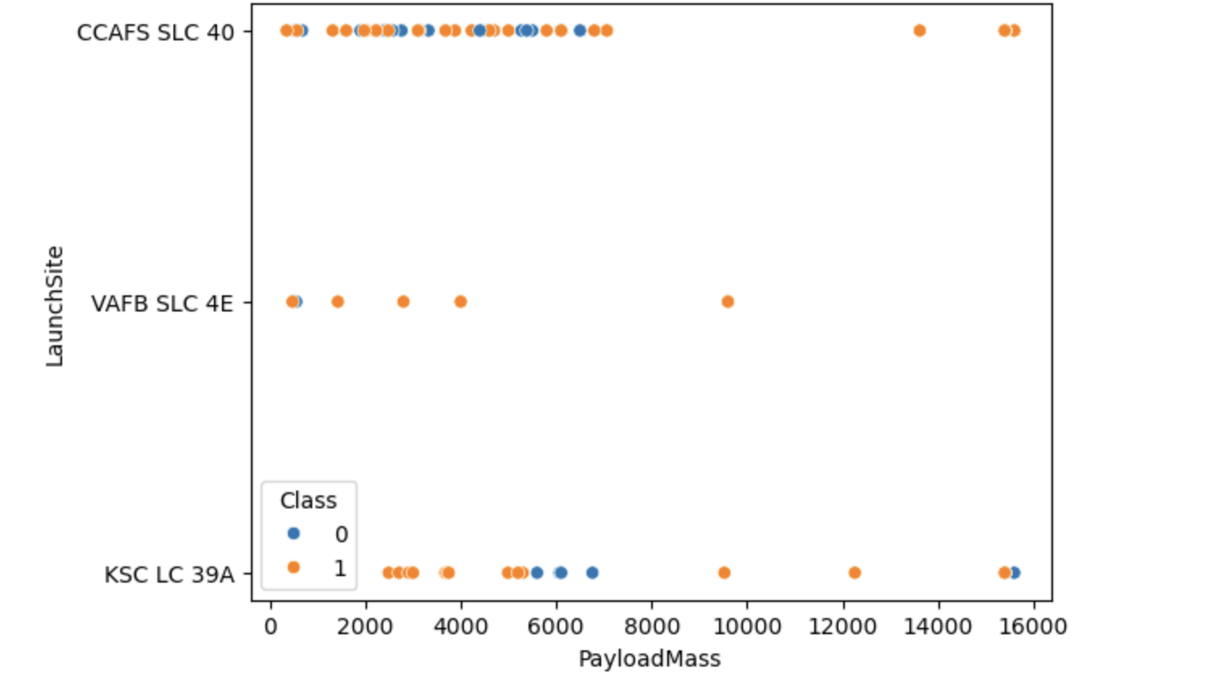
Payload vs. Launch Site
For VAFB-SLC launch site, there are no rockets launched for heavy payload mass (greater than 10000).

Slide 19
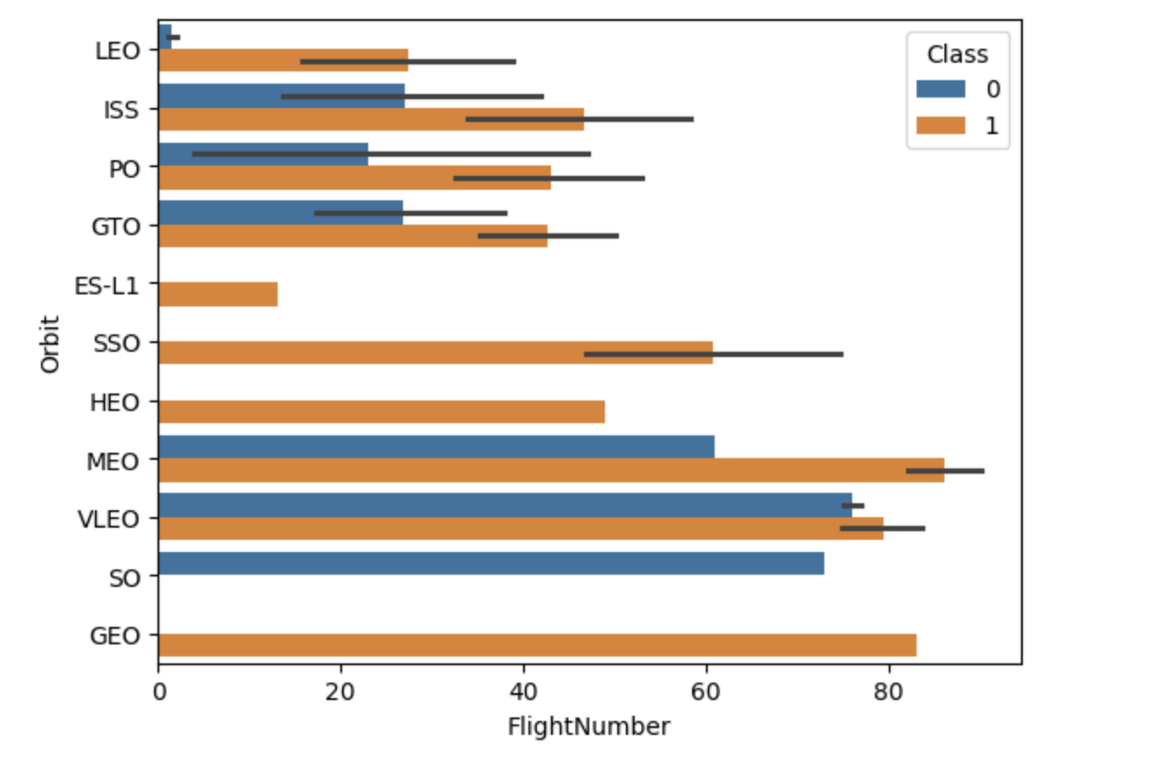
Success Rate vs. Orbit Type
MEO and GEO has the highest success rate out of all of the orbits.

Slide 20
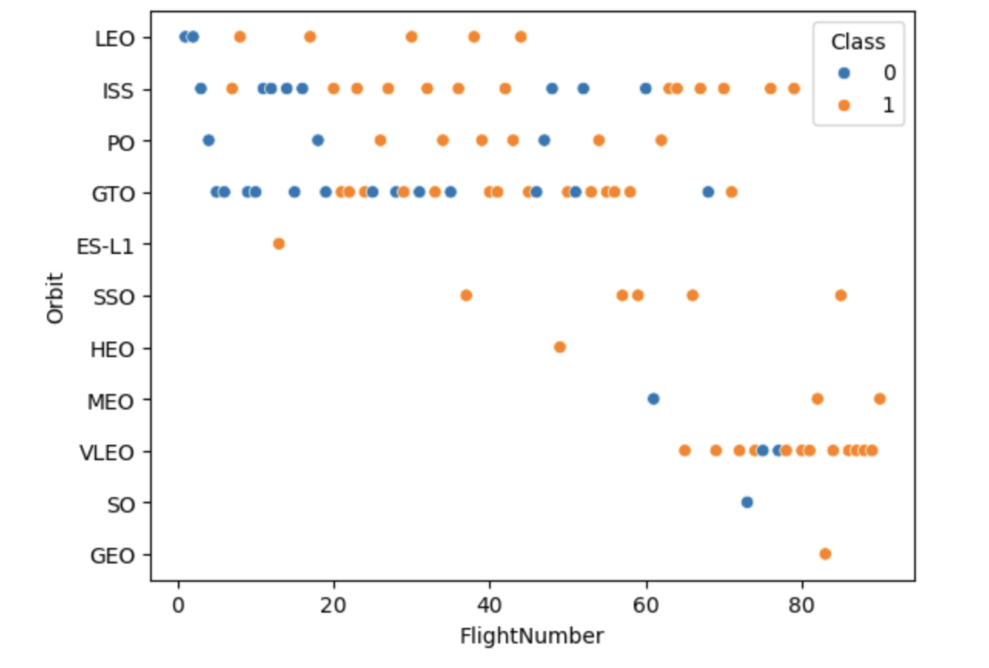
Flight Number vs. Orbit Type
LEO orbit the Success appears related to the number of flights; on the other hand, there seems to be no relationship between flight number when in GTO orbit

Slide 21
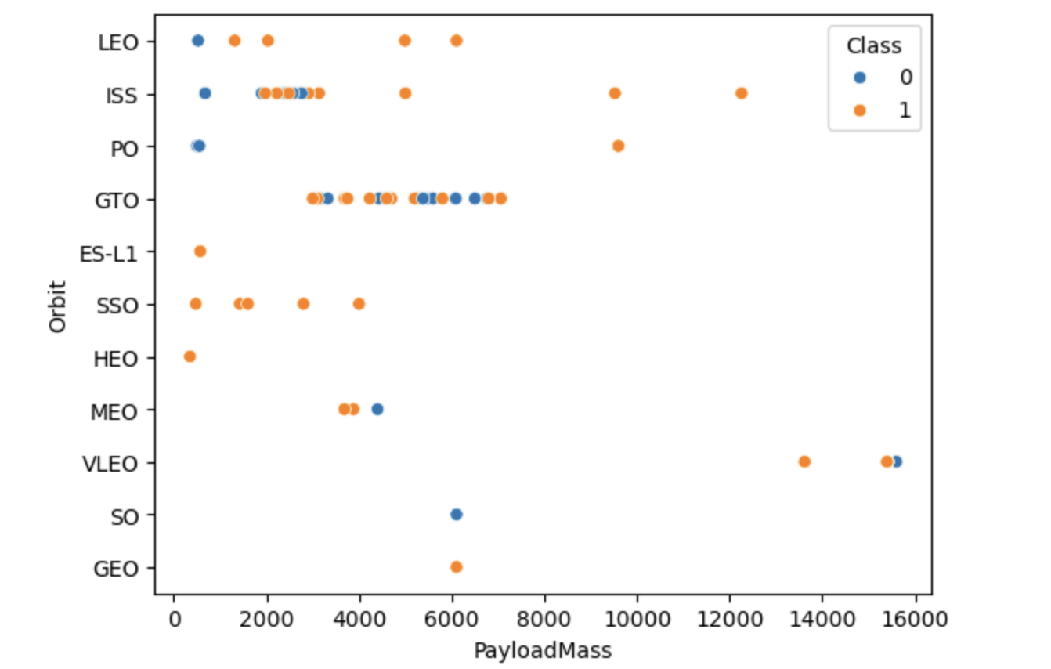
Payload vs. Orbit Type
With heavy payloads the successful landing or positive landing rate are more for Polar, LEO and ISS.
However for GTO we cannot distinguish this well as both positive landing rate and negative landing(unsuccessful mission) are both there here.

Slide 22
Launch Success Yearly Trend
Observe that the success rate since 2013 kept increasing till 2020

Slide 23
All Launch Site Names
Found names of unique launch sites by using Distinct query:
CCAFS LC-40
VAFB SLC-4E
KSC LC-39A
CCAFS SLC-40

Slide 24
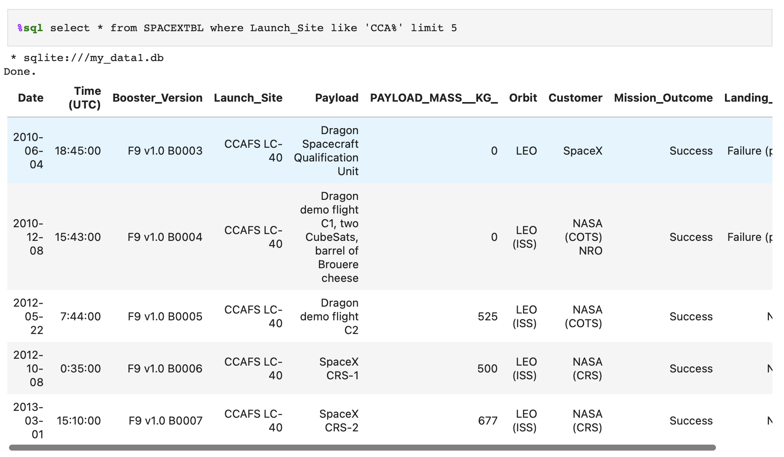
Launch Site Names Begin with 'CCA'
By using Like query and % in quotations, I can find the launch sites that begin with CAA

Slide 25
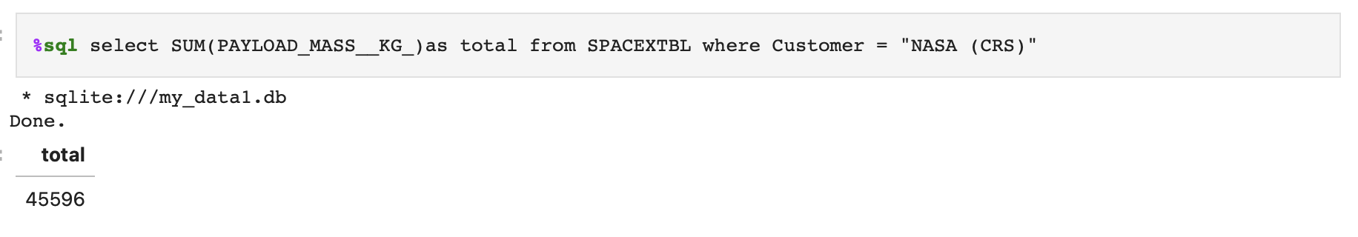
Total Payload Mass
Total payload carried by boosters from NASA = 45,596 kg
This can be found by using SUM( ) and specifying WHERE the customer is NASA

Slide 26
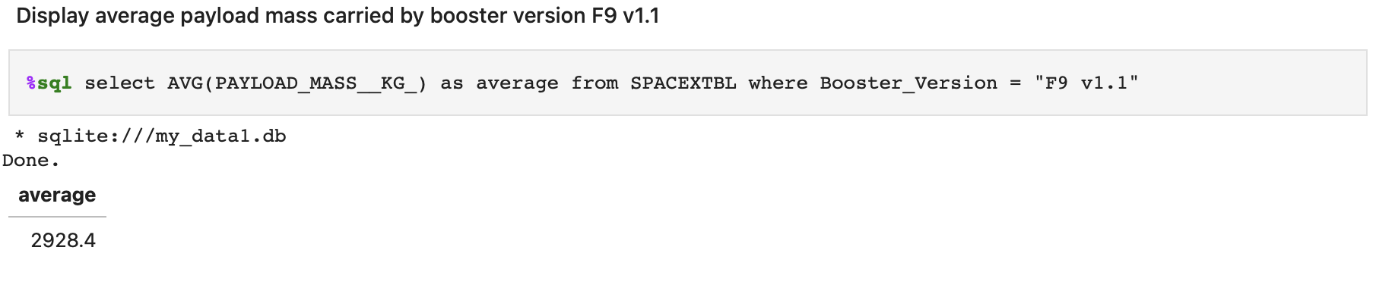
Average Payload Mass by F9 v1.1
Average payload mass carried by booster version F9 v1.1 = 2,928.4 kg
The average can be calculated by AVG( ) query and by specifying WHERE the version is F9 v1.1.

Slide 27
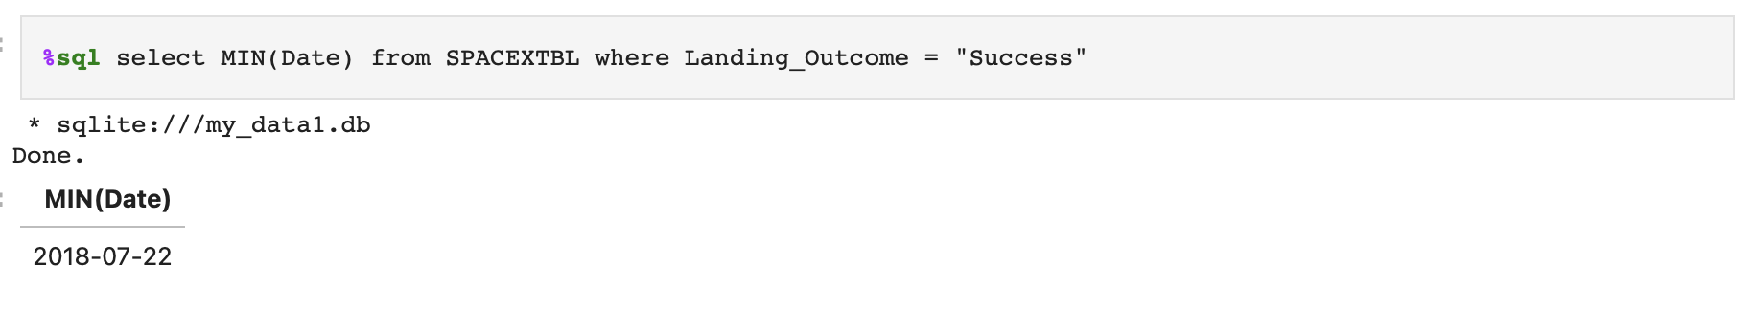
First Successful Ground Landing Date
The first successful landing outcome on ground pad = 2018-07-22
SQL will output the earliest date when the MIN query is used to find the first occurrence of success.

Slide 28
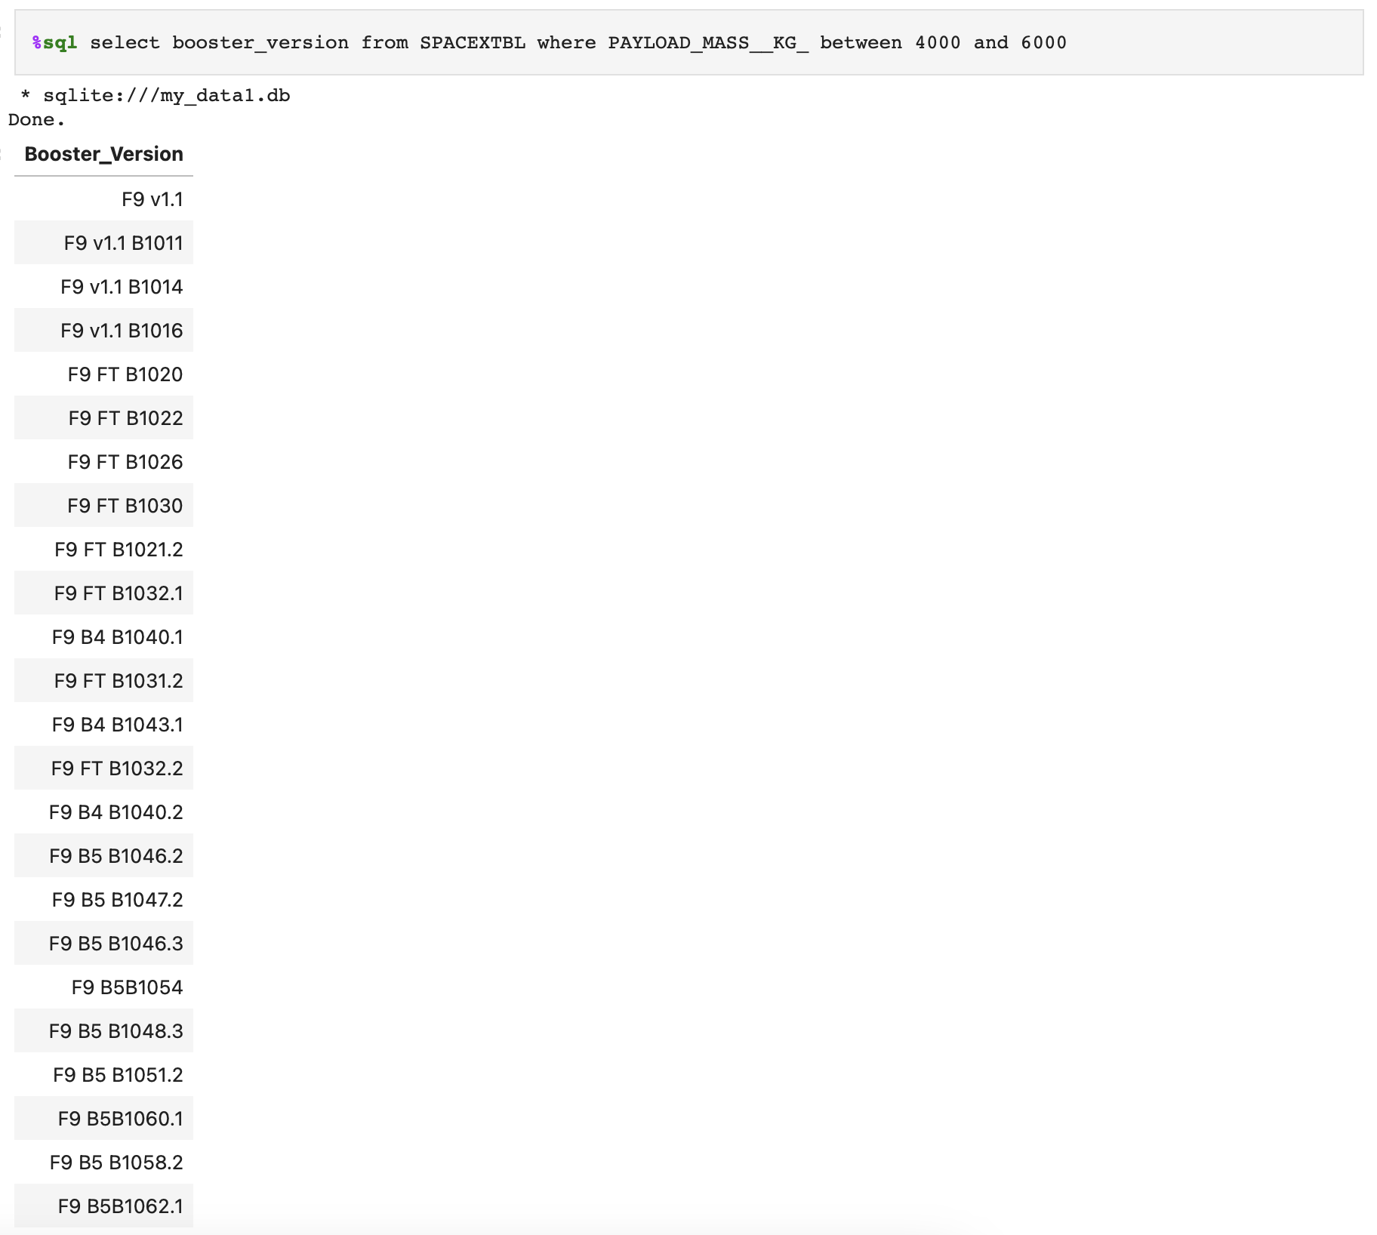
Successful Drone Ship Landing with Payload between 4000 and 6000
The image shows the list the names of boosters which have successfully landed on drone ship and had payload mass greater than 4000 but less than 6000.
This was achieved by using the BETWEEN query.

Slide 29
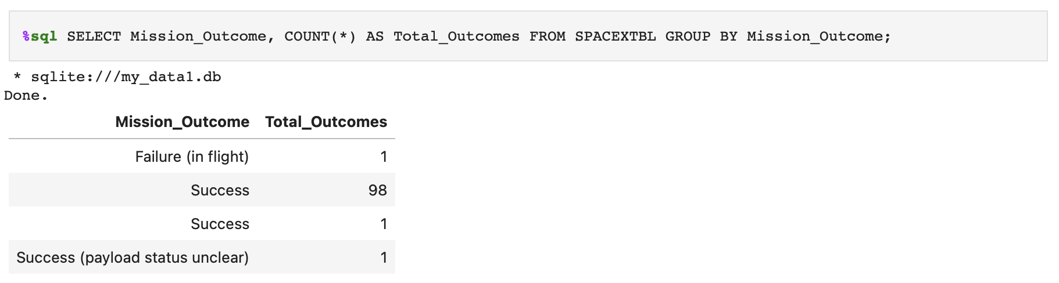
Total Number of Successful and Failure Mission Outcomes
Total number of successful outcomes = 100
Total number of failure mission outcomes = 1

Slide 30
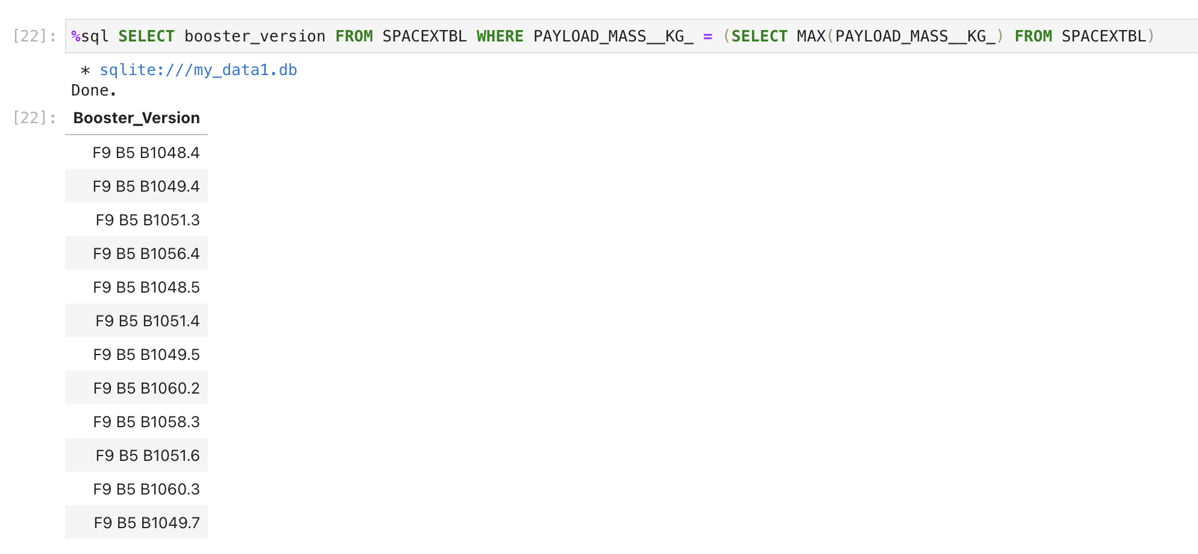
Boosters Carried Maximum Payload
Below image shows the names of the booster which have carried the maximum payload mass

Slide 31
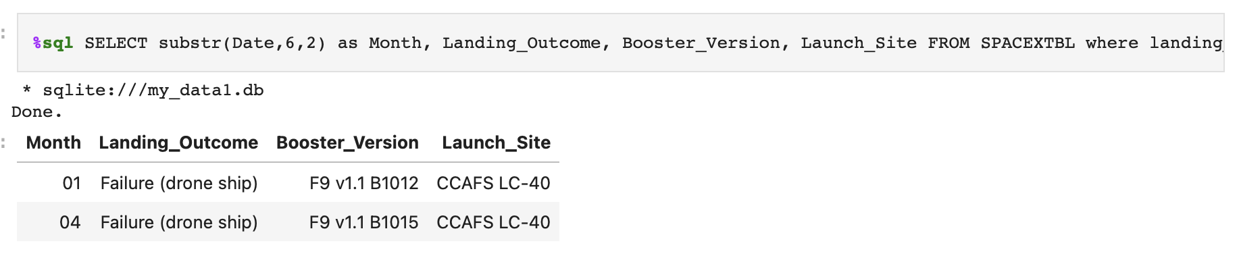
2015 Launch Records
The image below shows the failed landing_outcomes in drone ship, their booster versions, and launch site names for in year 2015.
This occurred only on the launch site CCAFS LS-40.

Slide 32
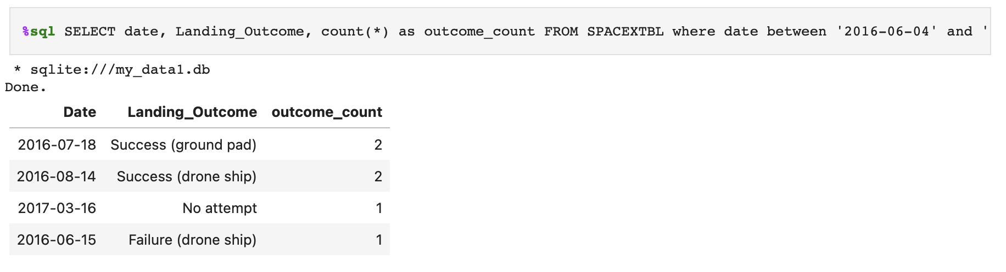
Rank Landing Outcomes Between 2010-06-04 and 2017-03-20
The data below shows the count of landing outcomes (such as Failure (drone ship) or Success (ground pad)) between the date 2010-06-04 and 2017-03-20, in descending order.
All successful outcomes were accomplished on 2016.

Slide 33

Section 3

Slide 34
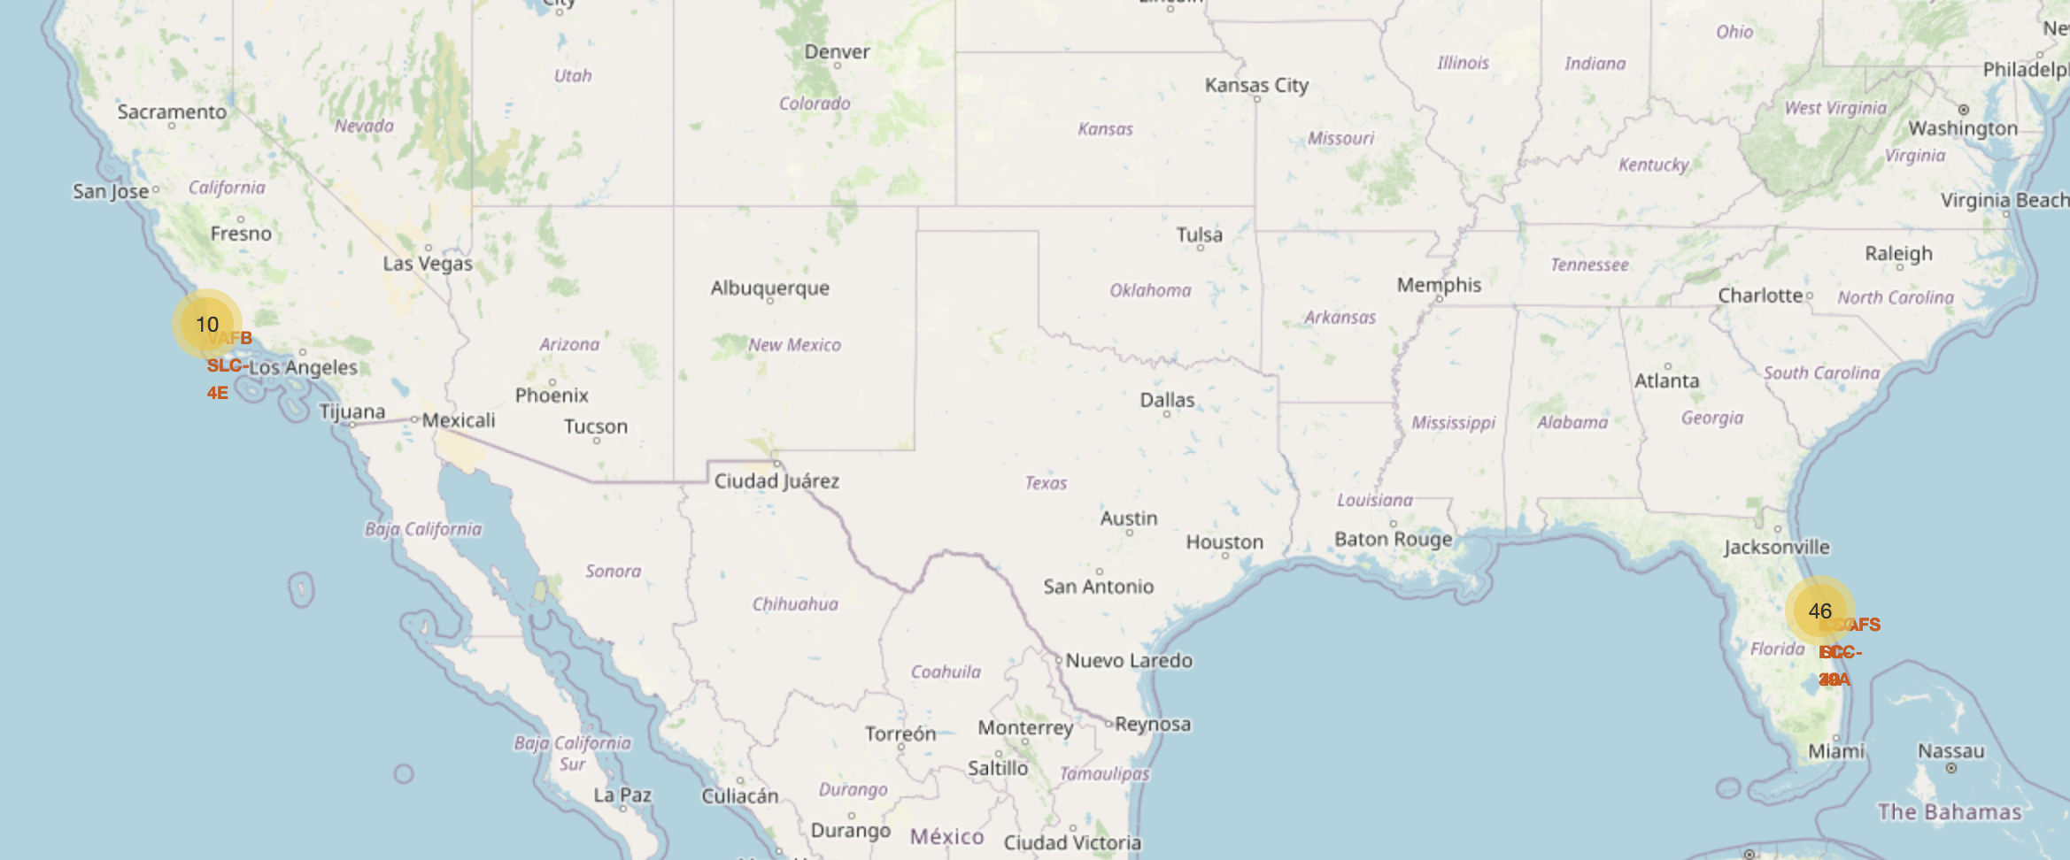
All Launch Sites’ Location
There are 10 launch sites located in California and 46 launch sites located in Florida.
From the map shown above, launch sites are located near shores and locations with mild weather.

Slide 35
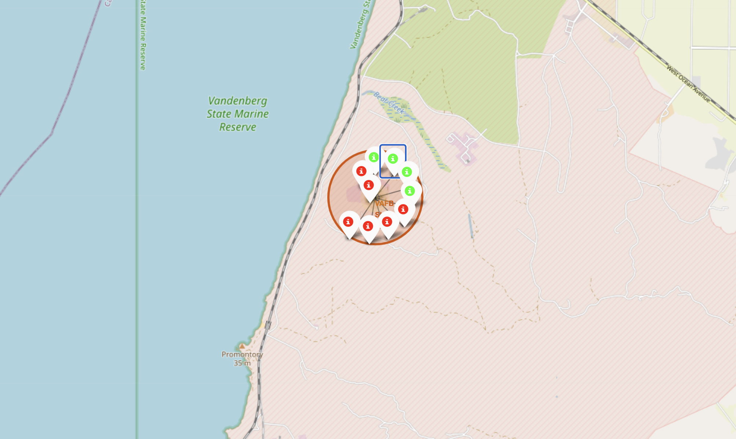
Mark the success/failed launches for each site on the map
Folium map shows the color-labeled launch outcomes on the map
Green indicates successful launches and red indicates failed launches.

Slide 36
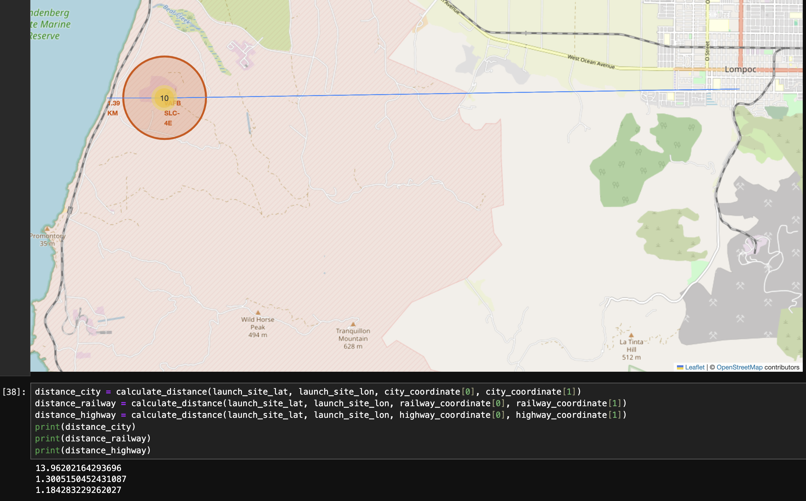
Calculate the distances between a launch site to its proximities
The generated folium map shows proximities such as railway, highway, coastline to the site.
Highway and railways are nearby a launch site. However, a city is far away.

Slide 37

Section 4

Slide 38
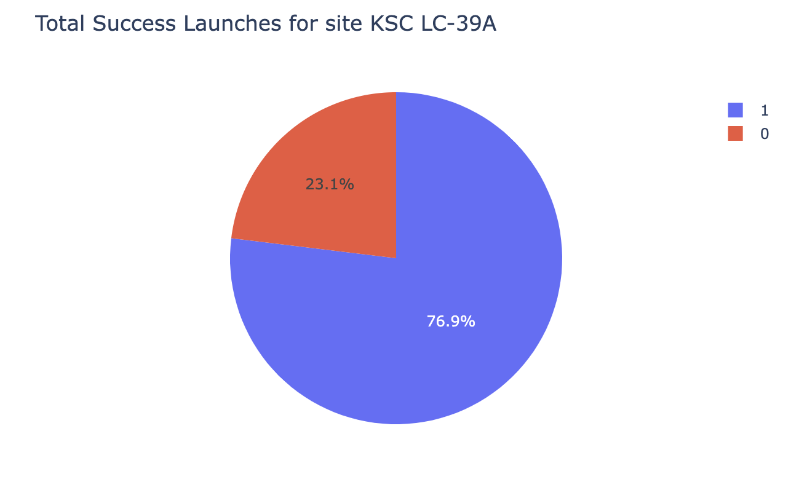
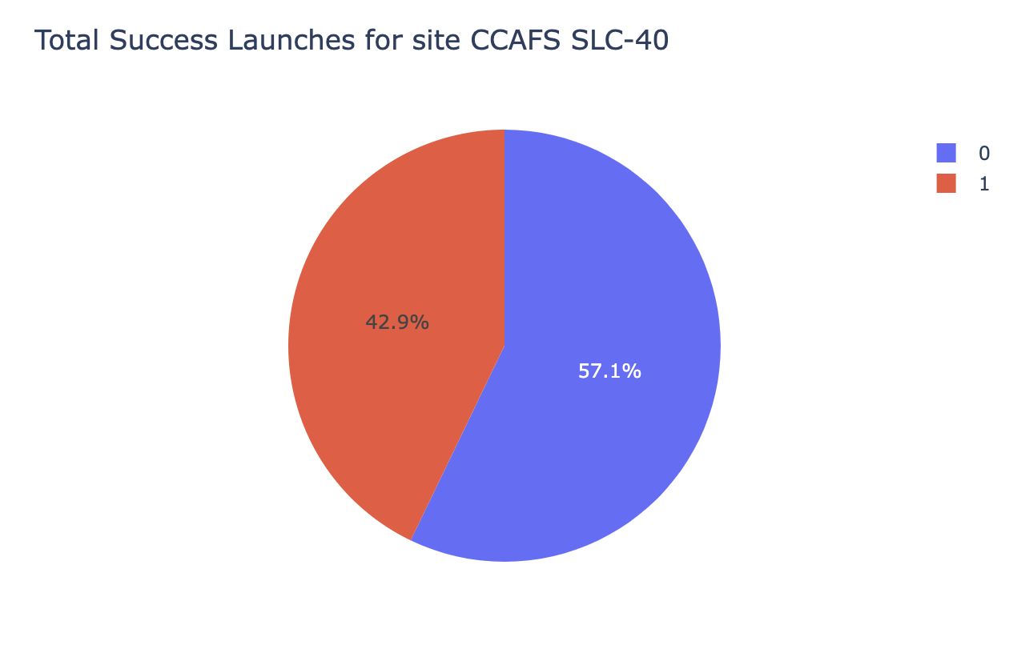
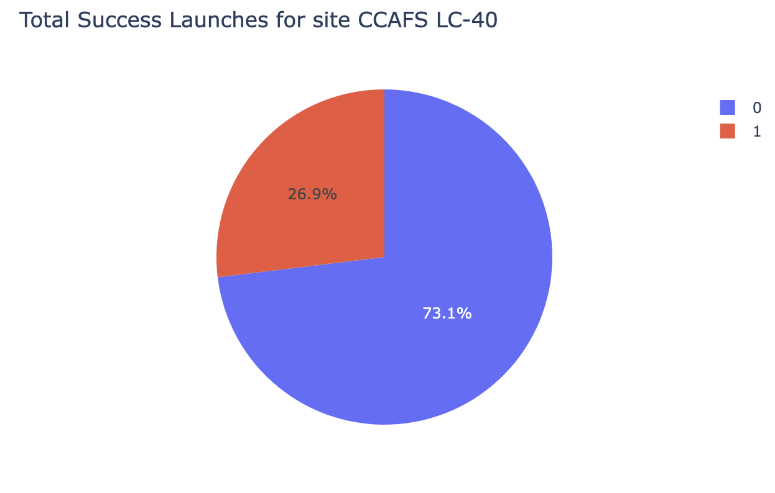
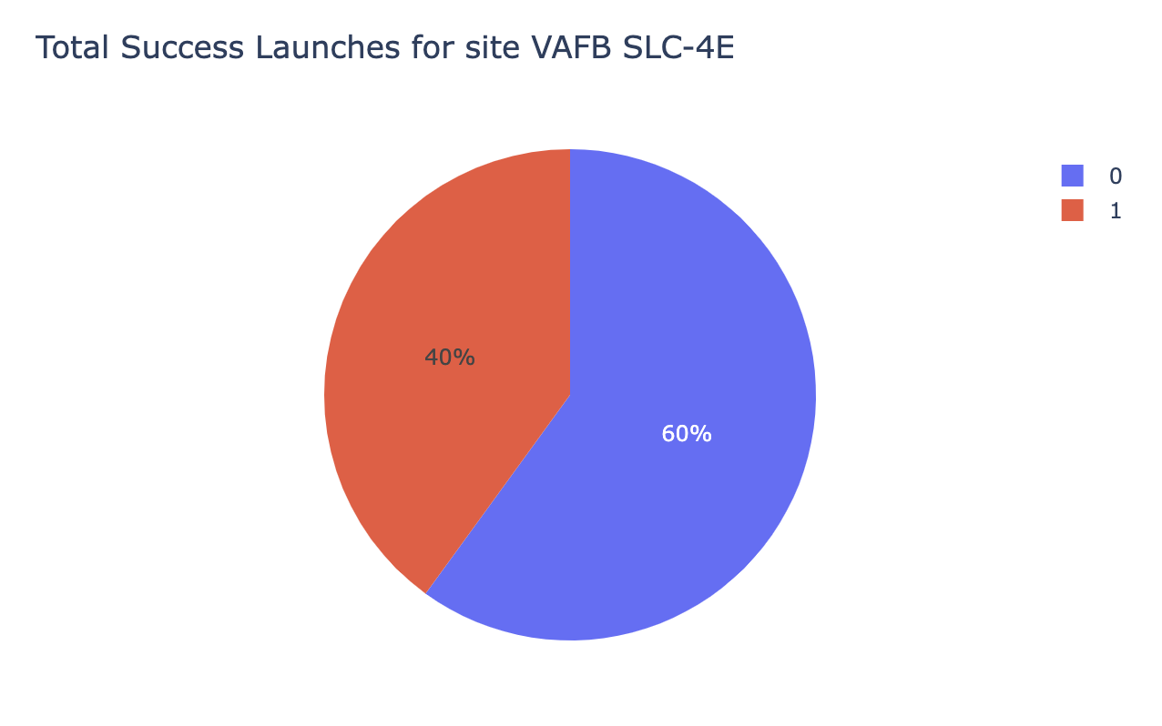
Launch Success of All Sites
Site KSC LC-39A has the highest successful launches. Followed by CCAFS LC-40.

Slide 39
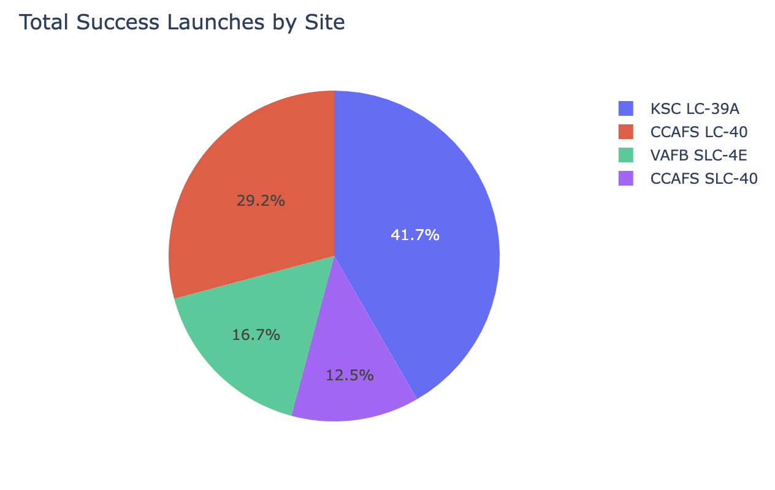
High Launch Success Ratio
KSC LC-39A has the highest launch success ratio compared to other launch sites.

Slide 40
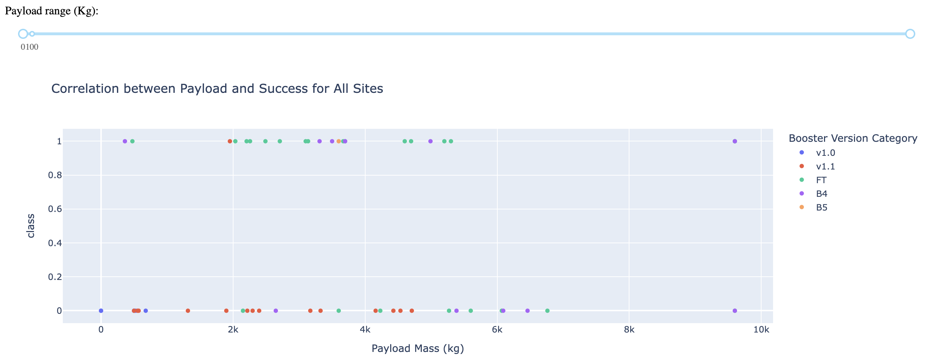
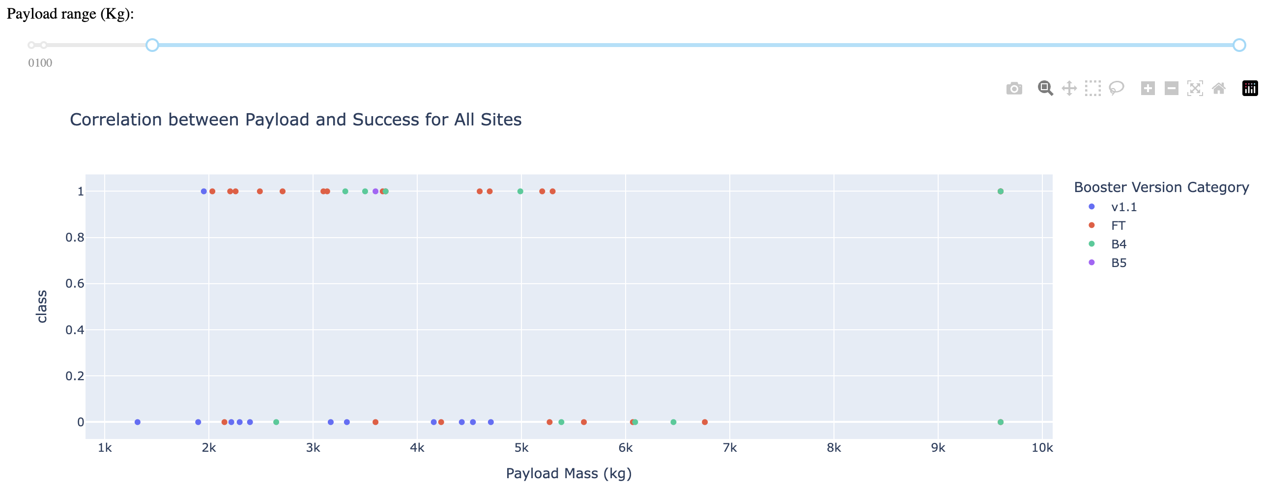
Payload vs Launch Outcome Scatter Plots
FT has the largest success rate while v1.1 has the lowest success rate.
Payload range of 2k-4k has the highest number of successful launches
Only B4 has attempted launches above 7k and has a 50/50 chance of success.
FT has a higher success rate between payload ranges of 2k-3k.

Slide 41

Section 5

Slide 42
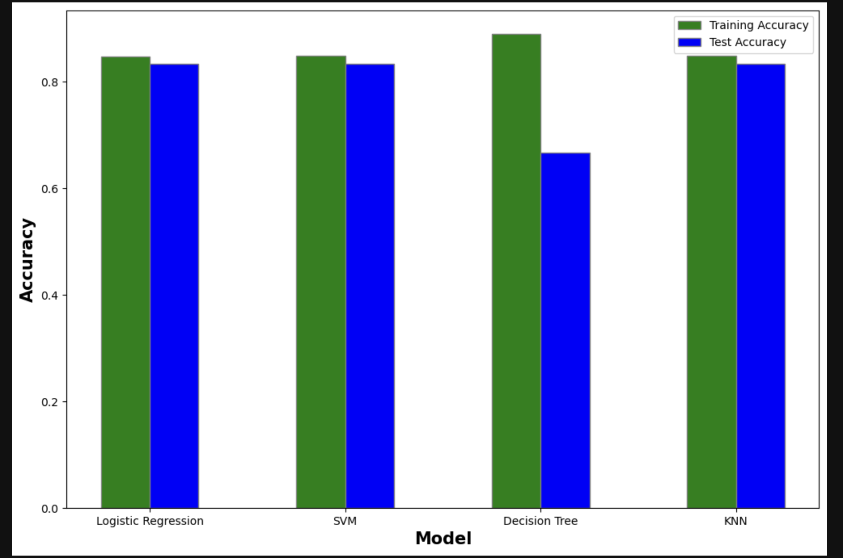
Classification Accuracy
Decision tree has the highest classification accuracy of 88.9%. However, it has the lowest test accuracy.
Logistic regression, SVM and KNN all have very similar test accuracies.

Slide 43
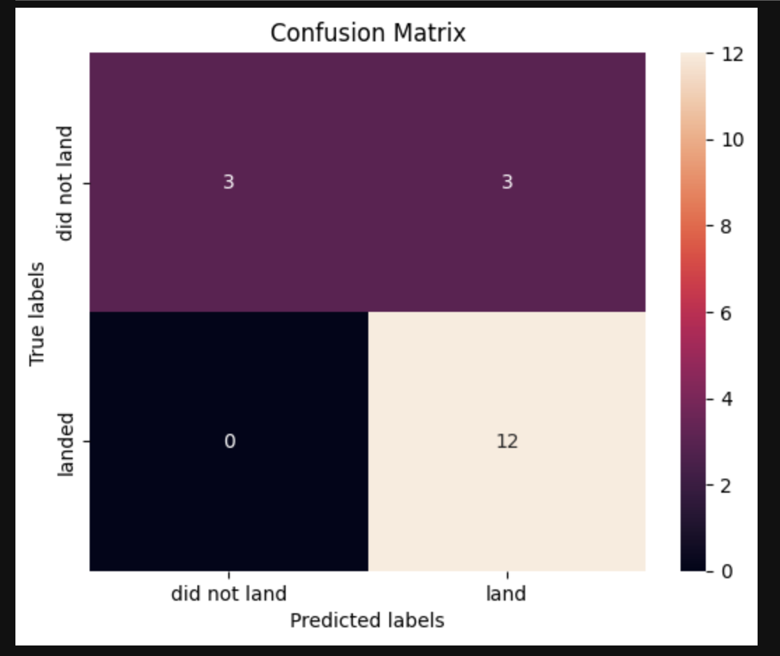
Confusion Matrix
Logistic regression, SVM and KNN all have very similar test accuracies.
They also have the same confusion matrixes as shown on the side.

Slide 44
Conclusions
Success rates generally increasing with time.
Sites CCAFS LC-40 or CCAFS SLC-40 have highest chances of success.
Payloads below 6000kg have higher changes of success.
Logistic regression, SVM and KNN all have very similar test accuracies, approx. 83%.

Slide 45


